Slide 1
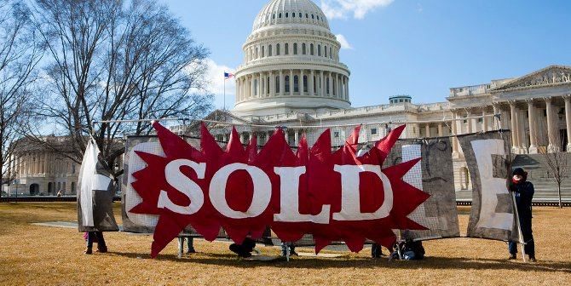

Follow the Money
Kate Field, J.A. Gorman, Richard Moseley, Angelique Tucker and Lauren Van Wagoner

Slide 2
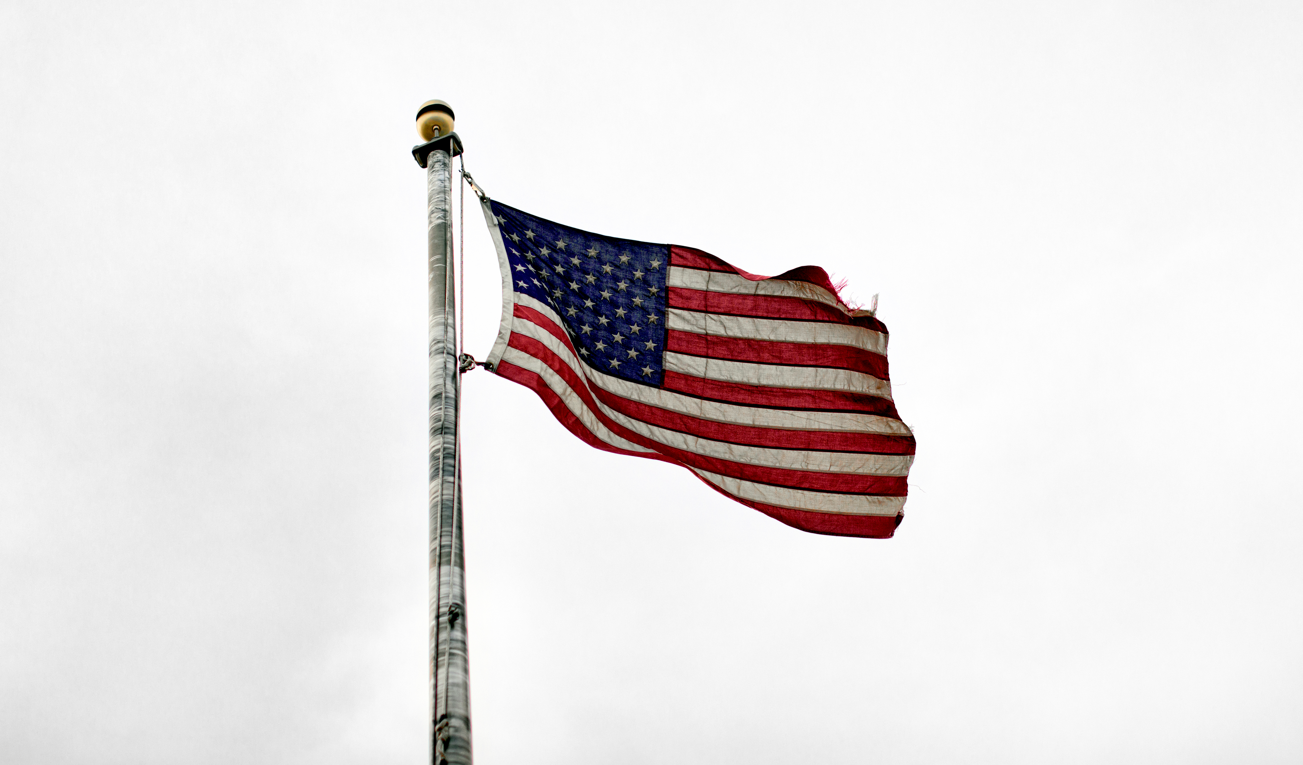
Overview
Kansas
Senate:
Jerry Moran
Roger Marshall
House Representatives:
Tracey Mann
Jake LaTurner
Sharice Davids
Ron Estes
We will be breaking down congressional districts in Kansas and Missouri and whether or not the top donors correlate with the candidate platform for Senate and House Representatives for the states of Missouri - Senate: 2 House: 8 and Kansas- Senate: 2 House: 4. Our machine learning will predict the donors who they give their money to by party.
Missouri
Senate:
Josh Hawley
Roy Blunt
House Representatives:
Cori Bush
Ann Wagner
Blaine Luetkemeyer
Vicky Hartzler
Emmanuel Cleaver
Samuel Graves
William(Billy) Long
Jason Smith
Italics: not a resident

Slide 3
Tableau
Is a great visualization software with many complex components. The system is segmented into individual simple systems that must be purchased separately in order to have a fully transition program.
Researched alternate sources for geomapping data to establish through google
Longitude and latitude of Districts House and Senate
Longitude and Latitude of Donors or Map by address
Our Group Intended to have a Map for Kansas and Missouri with the current House and Senate Representatives with their total donations by election year and the names of their Top 10 Primary Contributors.
Data Obtained
Legislators Names and Represented State as of January 2020
Total amount of Funds Donated and Campaign Funds
Candidate Party
Data Not Obtained or Incomplete
If the candidate was voted out or retired the new Candidate had not been updated in the API data
There is not geographical data for the Candidates or the Contributors to add data to the Map and layer.
The data obtained is extensive and in multiple files to be tied together.
(Insert the Combined Mapping vs the final mapping Kansas and Missouri Individually)

Slide 4
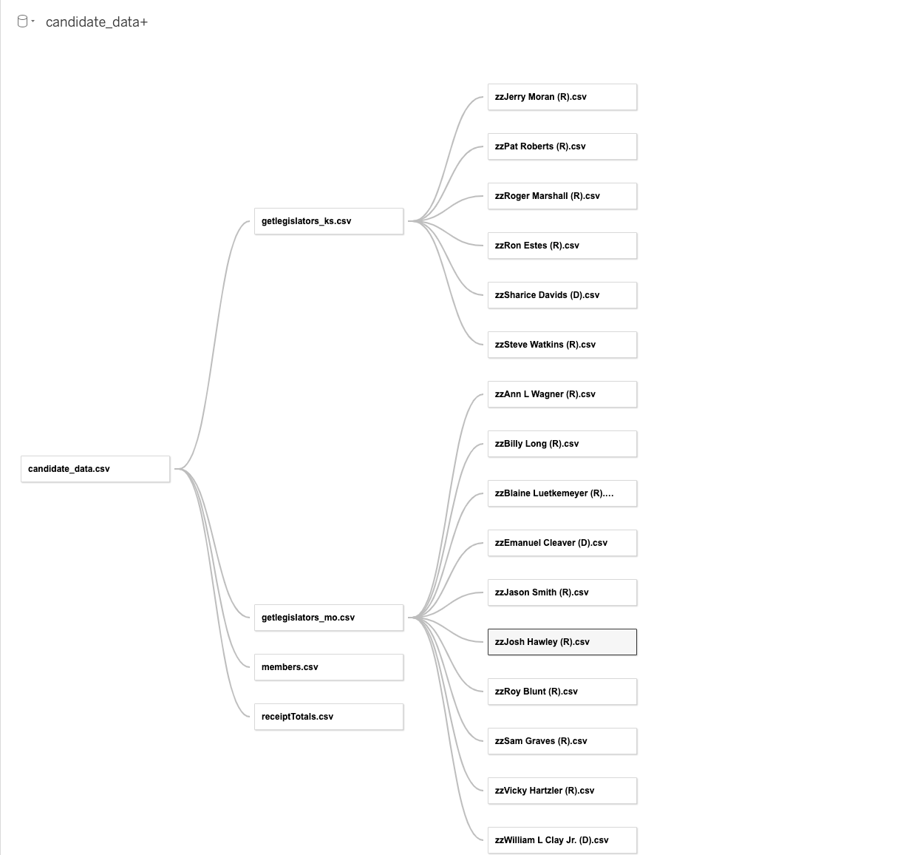
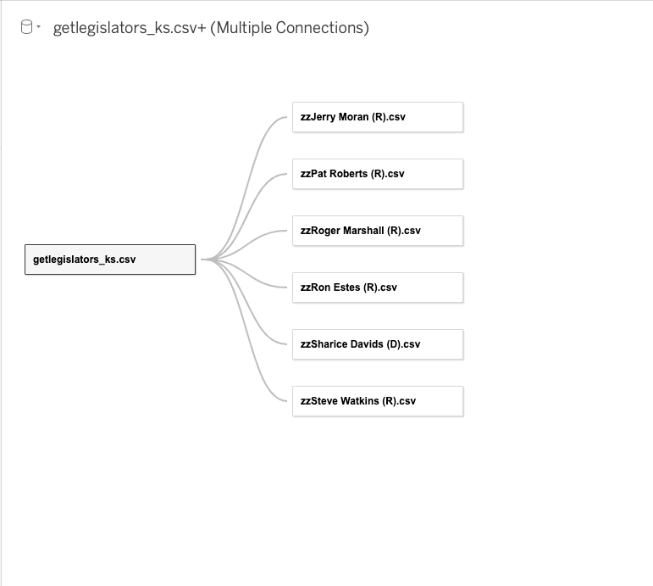
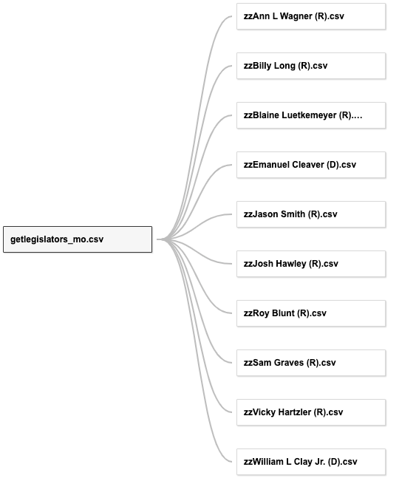
Combined Kansas Missouri

Slide 5
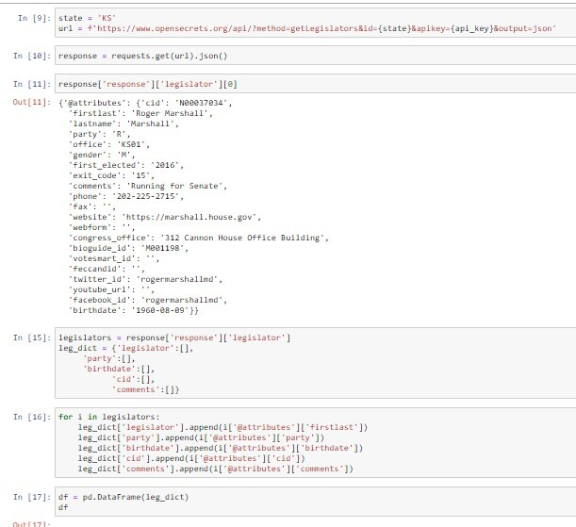
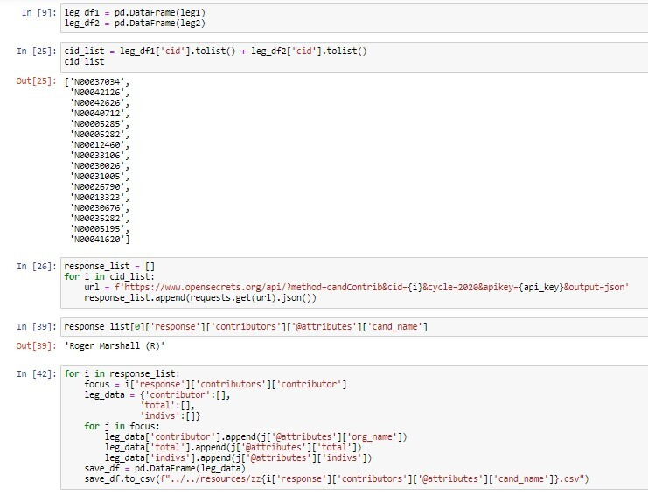
Jupyter Notebook

Slide 6
Machine Learning

Slide 7
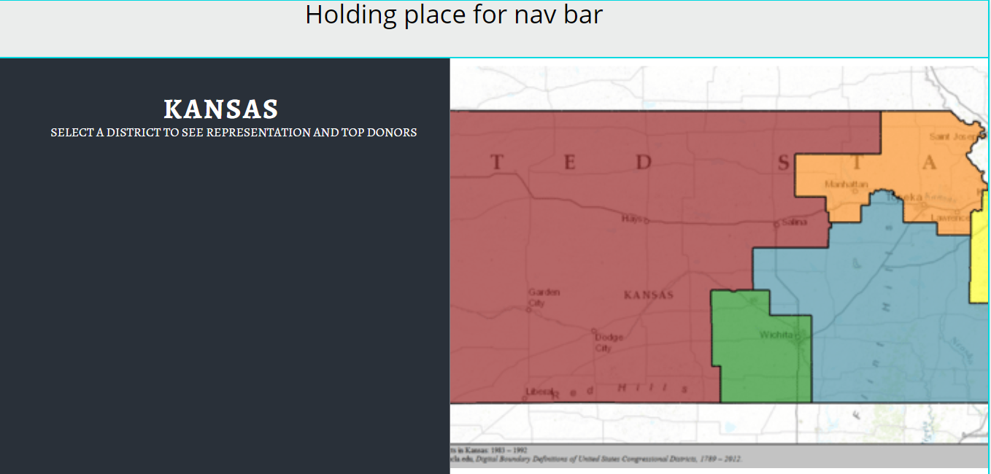
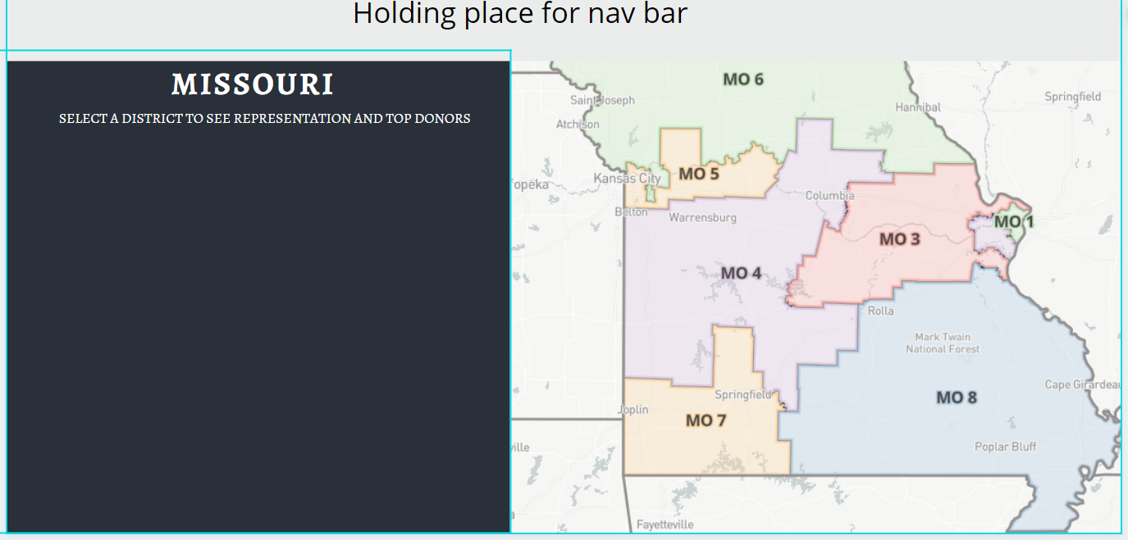
Design Ideas for Kansas and Missouri

Slide 8
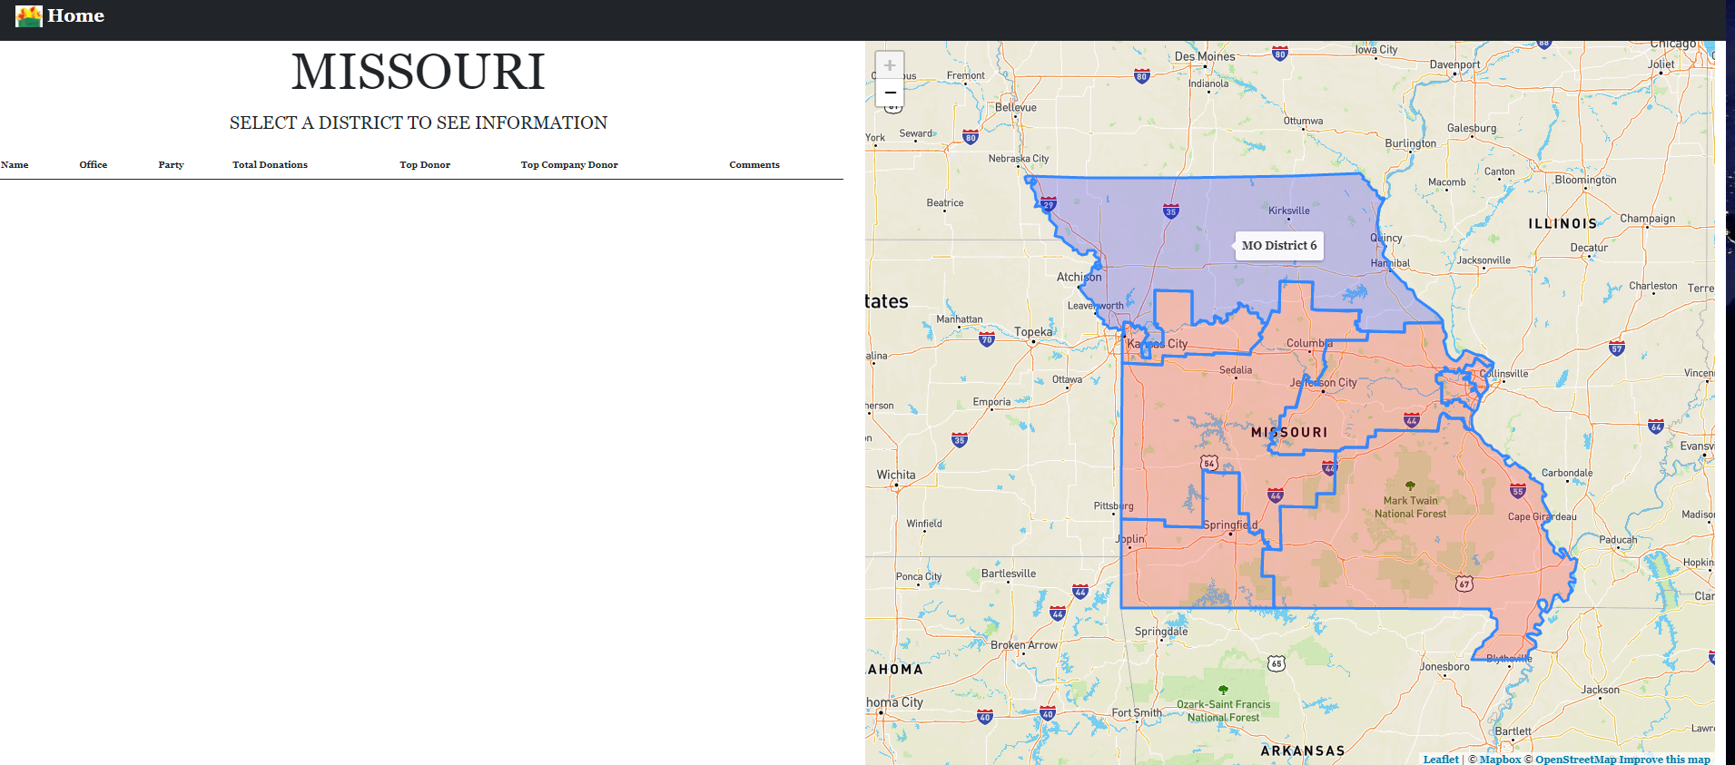
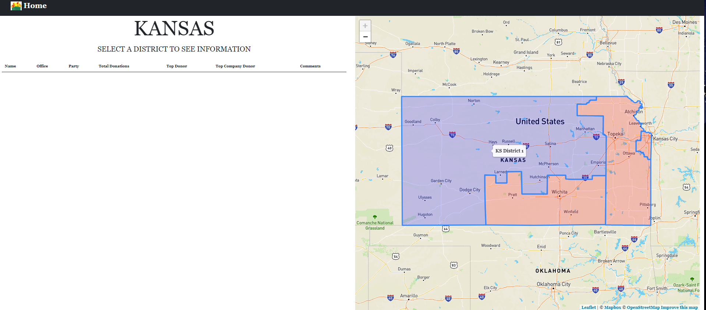
Progress for HTML Kansas and Missouri

Slide 9
HTML Map Design

Slide 10
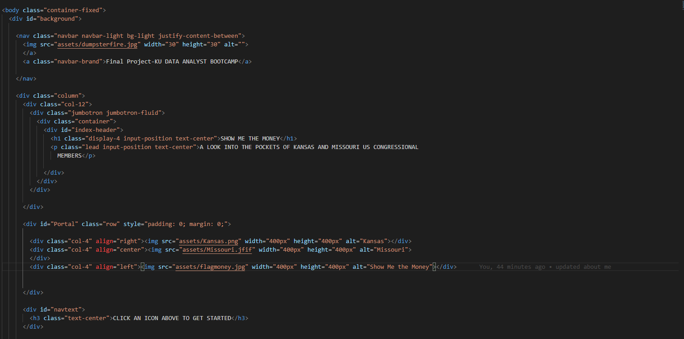
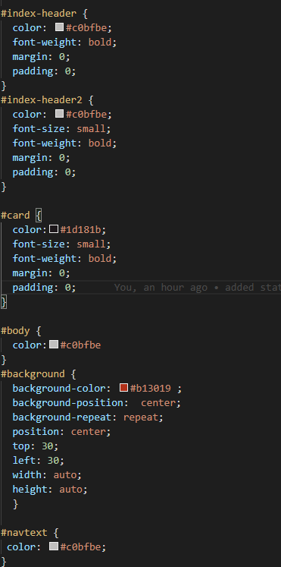
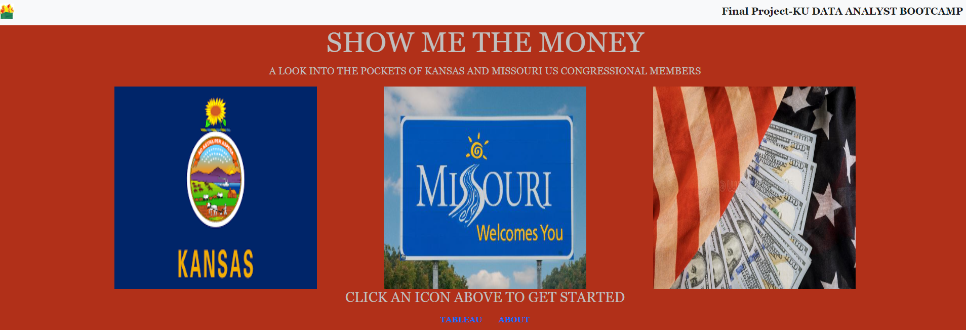
HTML Design

Slide 11
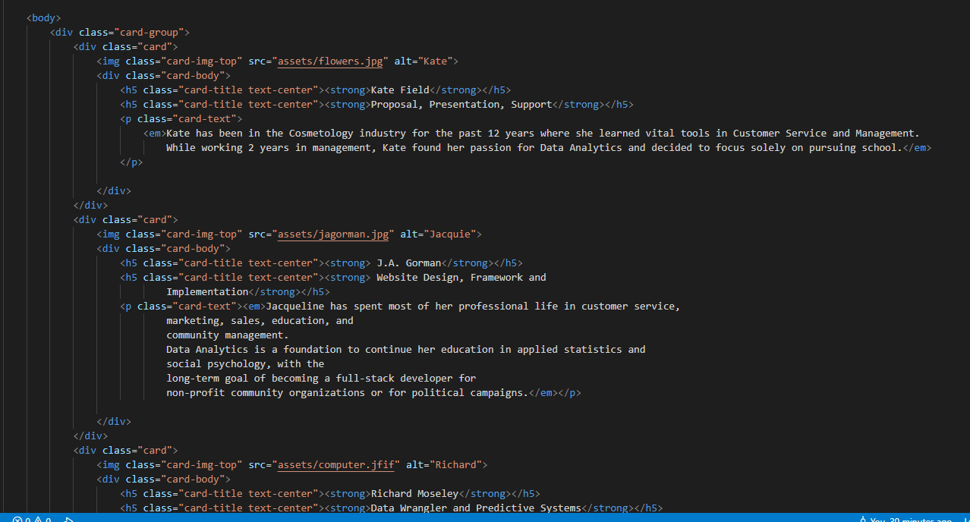
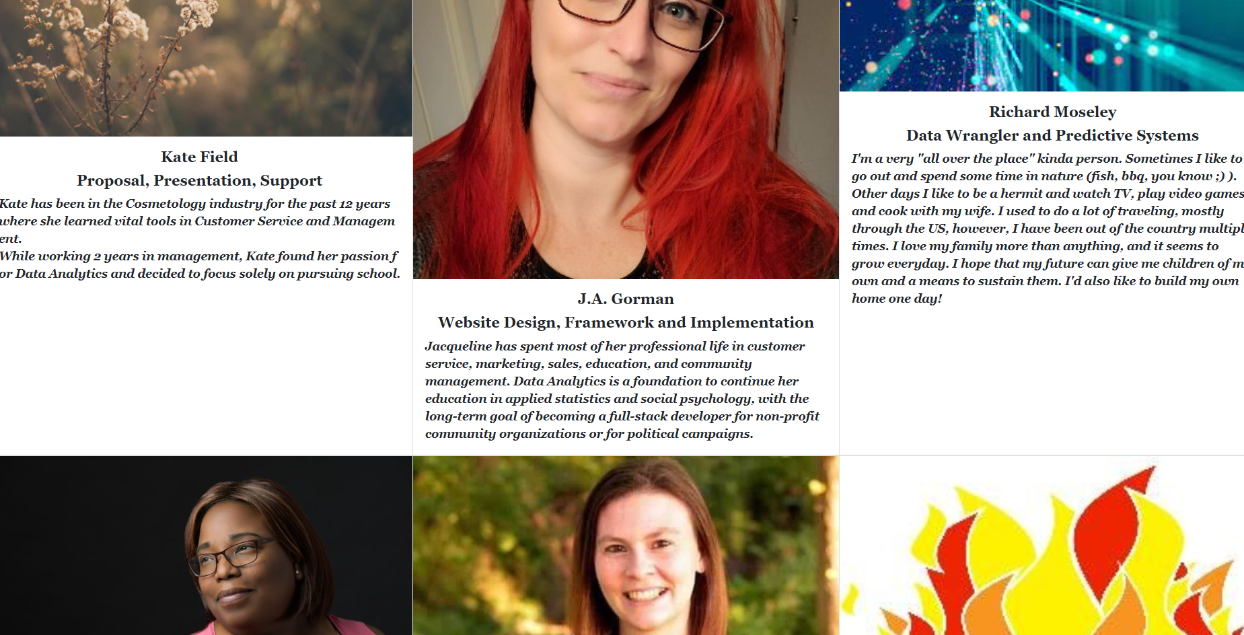
HTML Design

Slide 12
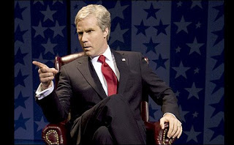
Git Hub Repository
https://jagorman.github.io/Follow-the-Money-2.0/index.html

